Slide 1

ASSOCIATION OF INDIAN UNIVERSITIES
East Zone Vice Chancellors’
Meet- 2022-23
13-14 December 2022
ICFAI UNIVERSITY, SIKKIM
INNOVATIVE PEDAGOGY & LIFELONG LEARNING
A Presentation by
Prof. Ganga Prasad Prasain
Vice Chancellor
Tripura University
(A Central University)
Tripura, India

Slide 2
PEDAGOGY
Beginning Of Pedagogy:
During the ancient period in Greece, the role of the teacher was first introduced, and teaching was considered as an art.
Attending school and getting education was something that only the wealthiest could afford for their kids.
The role of the teacher or an educator was considered the most important one in the learning process as they gave invaluable knowledge and wisdom to the children.
However, the educators weren’t the first pedagogues.
The rich individuals of the area used slaves to take their children to school.
They were considered as the experienced and wise who imparted knowledge to the children.
This is how the word pedagogue was created. It is described as the 'leader of children'. They guided the students academically and morally.

Slide 3
PEDAGOGY AS A METHOD
Pedagogy is a method of teaching in which teachers teach, both theory and practice.
It is a relationship between the culture and techniques of learning.
Pedagogy is shaped by educator's teaching beliefs and involves their understanding of culture and different learning styles.
It is essential for students to have meaningful classroom relationships in order to build on prior learning.
The main aim of pedagogy is to build on previous learning of the students and work on the development of skills and attitudes of the learners.
It enables the students to get a thorough understanding of the subject and helps them in applying those learning in their daily lives outside the classroom.

Slide 4
TYPES OF PEDAGOGY
1.Social Pedagogy - It is aimed towards the social development, awareness, and well-being of the students. It has two dimensions:values and moral education.
2.Critical Pedagogy - It aims towards comprehending and deconstructing several daily life problems and issues. It encourages the student to dig deeper into things and try to understand their thoughts and beliefs on a certain topic.
3.Culturally Responsive Pedagogy - It aims to address the cultural diversity among students. It helps to comprehend cultural differences among the students and increases awareness about cultural differences in school.
4.Socratic Pedagogy - It aims to encourage the students to gain more knowledge from other sources along with what is provided to them. This helps the students to find alternative solutions to the problems.

Slide 5
OUTCOMES OF PEDAGOGY
Character
Character refers to qualities of the individual essential for being personally effective in a complex world including: grit, tenacity, perseverance, resilience, reliability, and honesty.
Citizenship
Thinking like global citizens, considering global issues based on a deep understanding of diverse values with genuine interest in engaging with others to solve complex problems that impact human and environmental sustainability.
Communication
Communication entails mastery of three fluencies: digital, writing, and speaking tailored for a range of audiences.

Slide 6
Collaboration
Collaboration refers to the capacity to work interdependently and synergistically in teams with strong interpersonal and team‐related skills including effective management of team dynamics, making substantive decisions together, and learning from and contributing to the learning of others.
Creativity
Having an ‘entrepreneurial eye’ for economic and social opportunities, asking the right questions to generate novel ideas, and demonstrating leadership to pursue those ideas into practice.

Slide 7
Critical Thinking
Critically evaluating information and arguments, seeing patterns and connections, construction of meaningful knowledge and applying it in the real world.
‘E Squared’ (Ethical Entrepreneurialism)
Permeates the endless cycle of learning in action breaking the distinction between being able to work with the hands, the mind and giving a new, deeper meaning to the term ‘entrepreneurialism’. Entrepreneurialism is not just about making money but also being able to identify and resolve complex personal and societal challenges locally and globally.

Slide 8
INNOVATIVE PEDAGOGY
Innovation in pedagogy, like any kind of innovation, takes existing ideas, tools or practices and brings them together in new ways to solve problems when current practice is not adequately meeting the needs.
The choice of pedagogy has often been made ad hoc or based on whatever a teacher had encountered in their teacher education or their own schooling.
But where teachers are supported by high quality teacher education and strong professional infrastructures, they are enabled to make concerted decisions about pedagogy, acting as designers of learning by selecting approaches with a clear sense of their intended impact.
Developing and selecting pedagogies involves more than working out what is “effective” as indicated by impact on diverse measures of learning.
Different pedagogies are based on different theories of learning, and these theories entail different views of psychology and philosophy regarding what is most important in learning.
The full power of a pedagogy – and of pedagogical innovation – can only be evaluated in taking into account all the things the pedagogies are trying to achieve.

Slide 9
NEP 2020 Focuses on Innovation and Creativity

Slide 10
“ It is only when our universities will be able to produce a generation of innovators not initiators, planners not paper pushers, job creators ,not job seekers and original thinkers and not routine followers, only then our university graduates can confidently echo the statement of the great French Philosopher Descartes “Cogito, ergo sum “or “I think, therefore I am “and transform our society into a vibrate ,dynamic and living society .As has been well said ,”I” in India should stand for “Innovation” and not “Imitation”

Slide 11


Why creative students should be identified?

Slide 12

Creative people are the backbone of progress of any society & development of nation.

Slide 13
THE EXISTING ECONOMIC SCENARIO
India has excellent progress in
Agriculture
Space
Atomic Energy, Electronic Information technology
Pharmaceuticals, etc
India is third economic power in the world
Our prosperity depends upon growth of industry
Which industry?
It is knowledge industry.

Slide 14
REQUIREMENTS OF KNOWLEDGE INDUSTRY
Qualified and skilled manpower
Computer-based technical knowledge
World-class management skill
Good quality of education
WORLD’S DEMOGRAPHY PROJECTIION-2020
Population of India growing fast
Western population growing very slowly
China’s population growth controlled
IT industry growing very fast
India have 4.7core surplus workforce

Slide 15

But ?
It is possible only when – Creativity nurtured & Quality of education is improved.
What to do for it?
The 4.7 crore workforce may dominate the world industry and make India an economic superpower
Provided that-
They are properly qualified.
If not, they will be burden on the Nation.

Slide 16
Growth of higher education
At the time of independence there were 20 Universities and 500 Colleges in India
At present
University and university level institutions 760
Central University 43
State Public University 316
Deemed University 122
State Private University 181
Central Open University 1
State Open University 13
Institution of National Importance 75

Slide 17
HUMAN CAPITAL FORMATION
We talk of Japan’s achievements but don’t follow them.
Japan has no resources except human one and it has developed it properly.
Any amount of investment in capital formation will not bring desired result if human resource is not developed
We know that India is spending very low in education and health

Slide 18
Promoting of Quality: Focus on
  Performance
  Curricular Reform
  Better human resource management
  High quality research & Innovation
  Technology assisted monitoring system
  Science, Technology
  Inter-University centre
  University housed networking centre to provide international quality support.

Slide 19
Issues to be addressed
Access:
Equality:
Quality:
Issues and challenges in Relation to Access.
Access remains limited and varies across socio- economic groups.
.
Issues and challenges in relation to Equality and Inclusion:
Overcoming Barriers to the Education of Marginalized section

Slide 20
Issues and challenges in Relation to Quality and Excellence.
Reforms in the Regulatory Environment
Implementing the reforms Agenda
Curricular Reforms.
Reforms in the Accreditation system and Ratings.
Integration of Technology in Teaching –Learning and outreach.
Enhancing Quality and Excellence in Higher Education:
Accreditation Mandatory
Attracting quality Faculty and continuous Faculty Development Programmers
Evaluation of Teachers by students and peer assessment
Networking of universities and colleges
Strengthening the E-Learning
Systemic Reforms for Good Governance
Multi-disciplinary research and innovation programmes
Curbing plagiarism

Slide 21
Enhancing Quality and Excellence in
Higher Education
The Issues
Majority of Colleges fail to inculcate quality education
Medium of education, Hindi/regional languages
Non-availability of quality text books
No research orientation at college level
Frontier of knowledge be enhanced
No Articulation of internationalization of higher education
Global platform for knowledge seekers

Slide 22
1. Reform Agenda (Academic, administrative, curricula and pedagogy)
Teaching & Learning
Discovery and innovation
Engagement with social concern
2. Structural and System Reforms
Robust Policies
Pragmatic Program
Good Governance
3. Academic Reform
Semester System
Grading System
Choice-based credit system
i Transfer of credits

Slide 23
4. Generating Knowledge Society
i Learner perspective
ii. Satisfaction of National and International demand
iii. Knowledge sharing and participation
5. Preserving the character of a University
i. Multi-disciplinary University
ii. Mandatory accreditation (1415 accredited out of 31324 colleges and 75 accredited out of 534 universities)
6. Academic Staff College
7. Quality faculty
i. Attract good teachers
ii. Faculty upgradation

Slide 24

But
It is possible only when-
Quality of education is improved
What to do for it?
Change According to Change
Be alert for first sign of change
Anticipate change when things are going right
Always look to the opportunities that change represents
Surround yourself with people who are open to change
Play to win
Respect yourself

Slide 25

Curriculum construction.
*Sports *NCC
*Cultural Activities *NSS
*Literary Activities

Slide 26
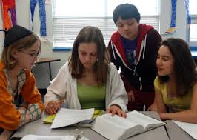
Avoid over-emphasizing the textual information.

Slide 27

Encourage divergent thinking

Slide 28
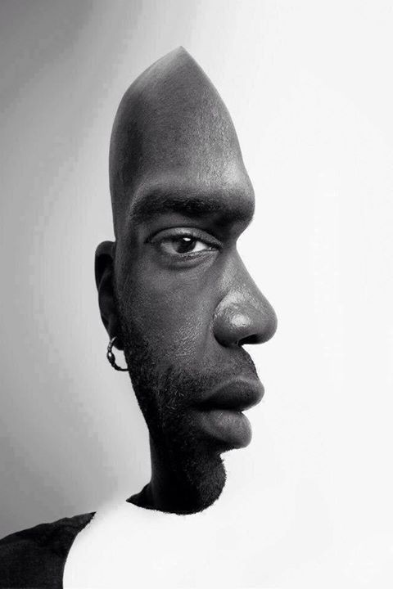
.
Use teaching aids properly.

Slide 29


Brain storming

Slide 30
So, esteemed scholars !
Let us change-ourselves & the environment for “quality education” for creation of “human capital”
With the confidence that we will bring change
Then only Bharat shall be Atmanirbhar in Education.

Slide 31
:SUGGESTION :
Barriers to Creativity and innovation must be overcome.
Innovating new ways to nurture the creativity of students must be a regular practice at all levels of education.
Encourage flexibility ,originality and elaboration in the classroom practice.
Students must be provided opportunities to experiment and reflect in all the subject areas.
Teacher should be respectful of unusual question.
Teacher should be respectful of unusual ideas of children.
We have to show children that their ideas have value.
We have to provide for periods of non-evaluated practice or learning.
Provision of incentives and awards to motivate the teacher to do continuously better.

Slide 32


Slide 33

THANK YOU

